Slide 1

Spring Framework
Beans Lifecycle and Annotations

Slide 2
Table of Content
Bean Scopes
What is the Singleton
Scopes types
How to Change the Scope
Bean Lifecycle
Dev process for Bean Lifecycle
Questions
5 minutes Break
Spring Configurations Types
From XML to Java Annotations
Why Configurations with annotations
Beans Configurations using Annotations
Beans Default ID
Questions
Thanks

Slide 3
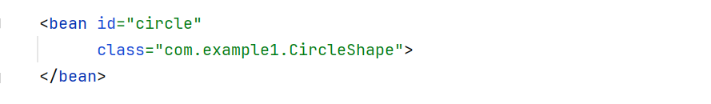

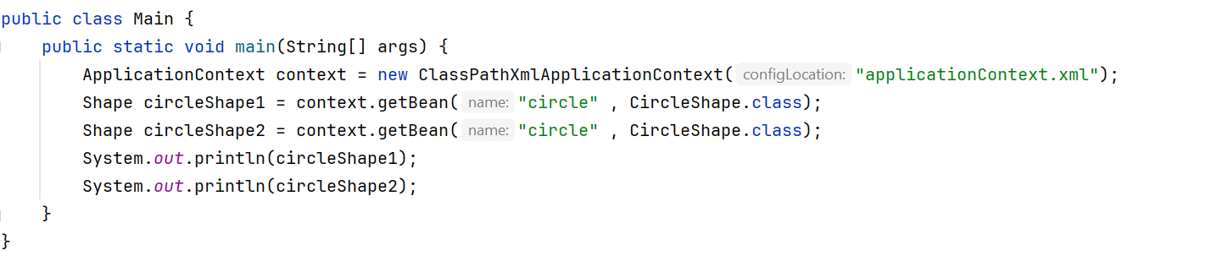
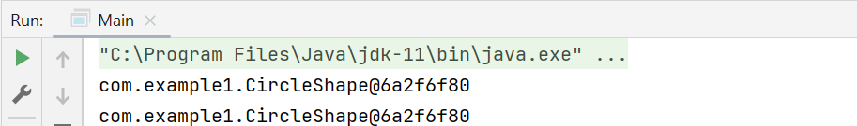
Bean Scopes
Scope refers to:
the lifecycle of a bean
How long does the bean live?
How many instances are created?
How is the bean shared?
So , What is the Default ?

Slide 4

What Is a Singleton?
Spring Container creates only one instance of the bean, by default
It is cached in memory
All requests for the bean
will return a SHARED reference to the SAME bean

Slide 5
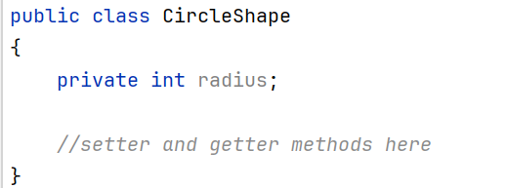
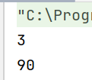
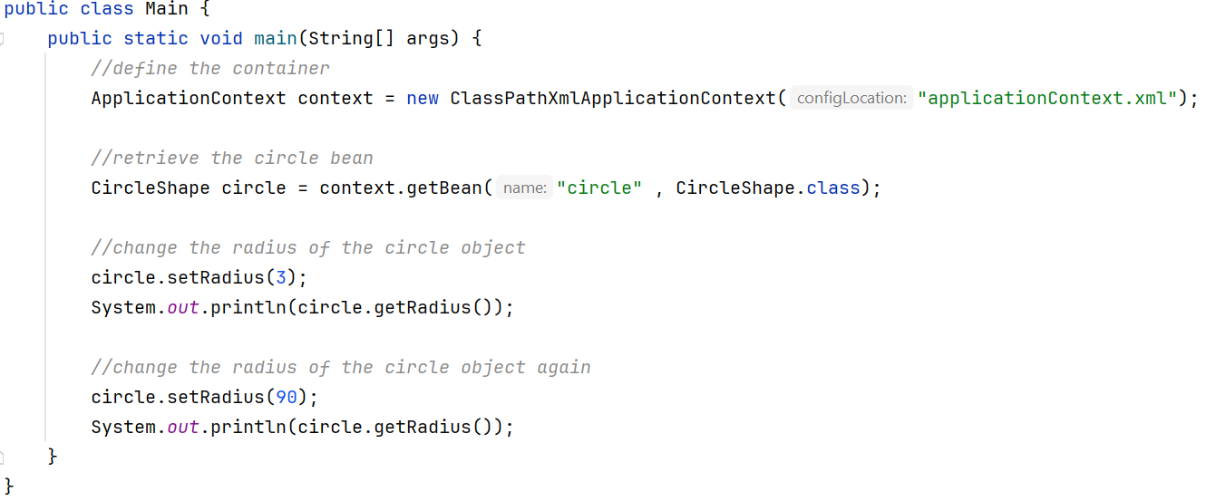

Slide 6
Scope types
Scope | Description
singleton | Create a single shared instance of the bean. Default scope
prototype | Creates a new bean instance for each container request
request | Scoped to an HTTP web request. Only used for web apps
session | Scoped to an HTTP web session. Only used for web apps.
global-session | Scoped to a global HTTP web session. Only used for web apps.

Slide 7
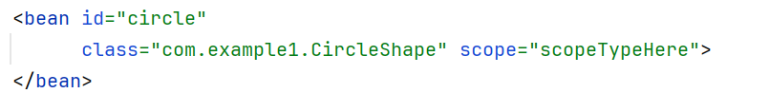
How to change the Scope

Slide 8
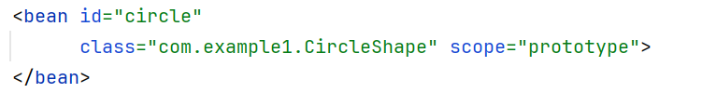
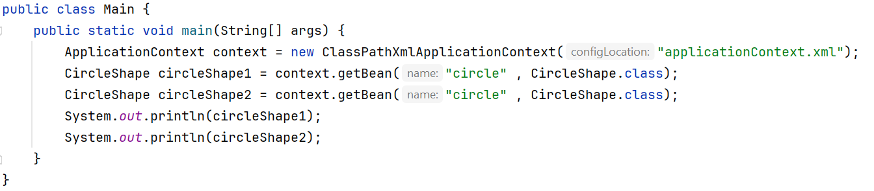

Code Example for Prototype Scope

Slide 9
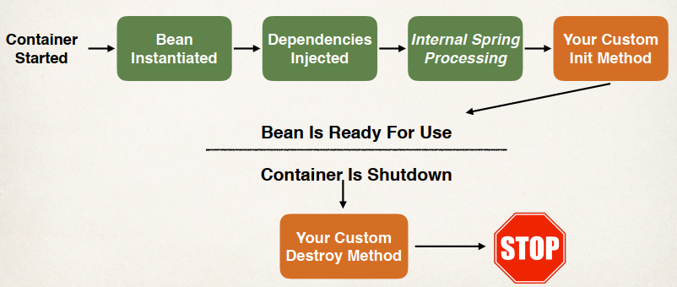
Bean Lifecycle

Slide 10
Bean Lifecycle Methods
You can add custom code during bean initialization
Calling custom business logic methods
Setting up handles to resources (db, sockets, file etc)
You can add custom code during bean destruction
Calling custom business logic method
Clean up handles to resources (db, sockets, files etc)

Slide 11
Development Process
Define your methods for init and destroy
Configure the method names in Spring config file

Slide 12
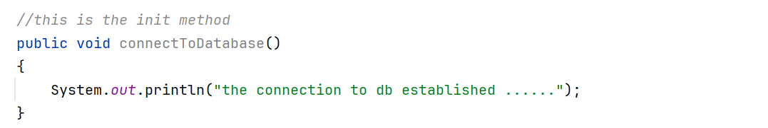
Init: method configuration

Slide 13
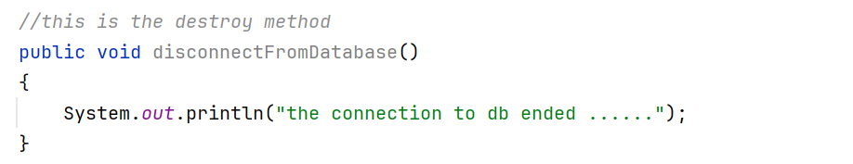
destroy: method configuration

Slide 14

Important Notes
If both the init and destroy methods inside the same class you can make the configurations like this:
The destroy method won’t be called without shutting down the container like this:

Slide 15
Spring Configurations Types
XML configuration file (legacy, but most legacy apps still use this)
Java Annotations (modern)
Java Source Code (modern)

Slide 16

From XML to Java Annotations (modern)

Slide 17
Why Spring Configuration with Annotations?
XML configuration can be verbose and long
Configure your Spring beans with Annotations
Annotations minimizes the XML configuration
Component Scanning instead of bean register
Dependency Injection without XML config (@Autowired)

Slide 18
How Spring Works with annotations ?
Spring Container will scan your Java classes for special annotations
Automatically register the beans in the Spring container

Slide 19
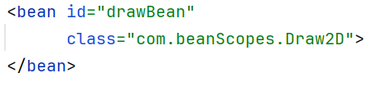
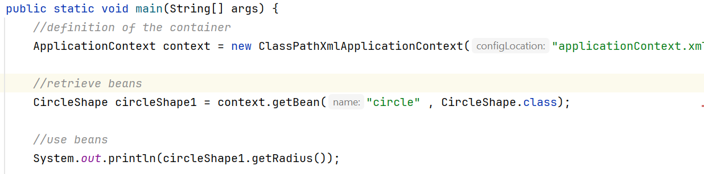
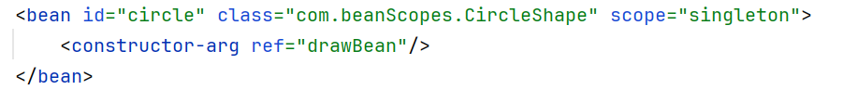
Old Style of Defining Beans (XML)

Slide 20
New Style of Defining Beans (Annotations)
Enable component scanning in Spring config file
Add the @Component Annotation to your Java classes
Retrieve bean from Spring container

Slide 21

1- Enable component scanning in Spring config file

Slide 22
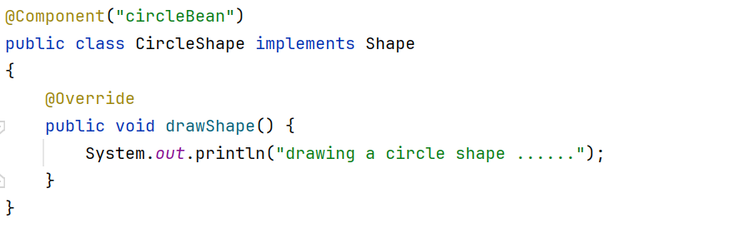
2- Add the @Component Annotation to your Java classes

Slide 23
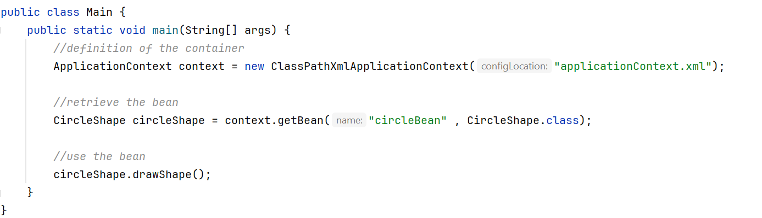
3- Retrieve bean from Spring container

Slide 24
Default Bean ID
Spring also support default bean ID. so , we can get rid of specifying an ID for each bean.
Class Name
CircleShape
Default Bean ID
circleShape
As you can see , make the first letter LOWER-CASE

Slide 25
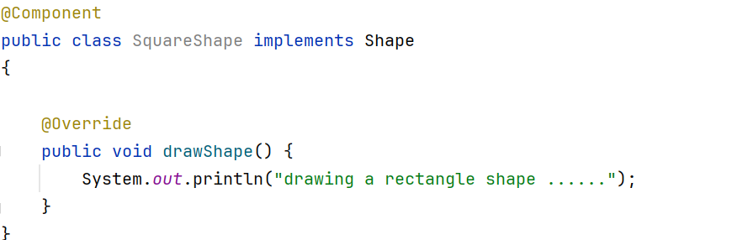
Default Bean ID (cont)

Slide 26
Questions ?

Slide 27
THANK YOU

